Slide 1
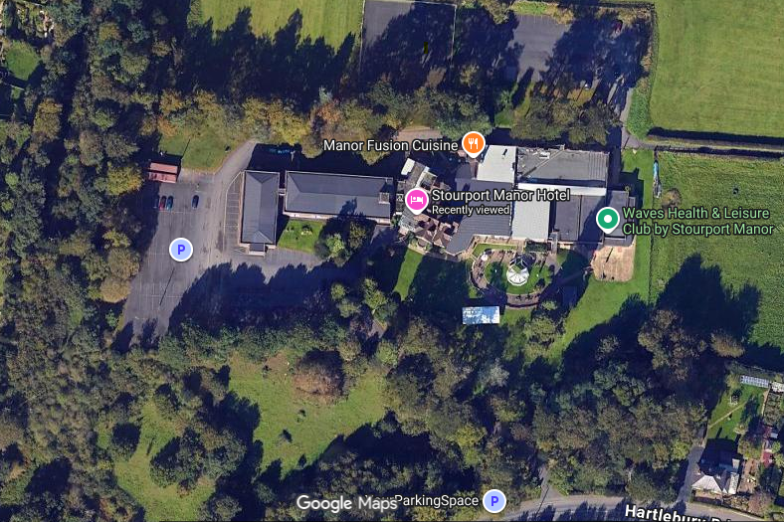
Car Park
Entrance

